Slide 1
HFI integration to scx_lavd
Srinivas Pandruvada, Intel

Slide 2
HFI Updates
3
Intel’s Hardware Feedback Interface (HFI) gives every CPU a performance and an efficiency class, and updates them as conditions change.
It can say two different things:
Exclude — PERF == 0 && EFF == 0: do not give this CPU work (FEATURE A)
Weaken — a lower perf class: the CPU delivers less (FEATURE B)
Energy efficiency: Efficient CPUs: EFF=255 (FEATURE C)
Hardware reports only when its recommendation changes

Slide 3
HFI Triggers
Over clocking run time update that changes the capability values
Change in run time physical constraints
Run time performance or energy efficiency optimization
Change in core frequency, voltage, or power budget

Slide 4
Ignoring HFI hints
3
A scheduler that ignores it:
Scheduler continue to use CPUs hardware has excluded
  Hardware will be more aggressive in excluding more CPUs
  Aggressive throttling
  Performance hit
Counts a throttled CPU at full strength: too few CPUs activated, incorrect ranking
Not using energy efficient CPUs
  Hardware changes energy efficient CPUs based on workload

Slide 5
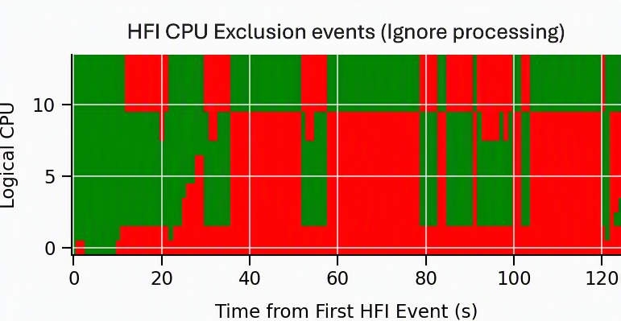
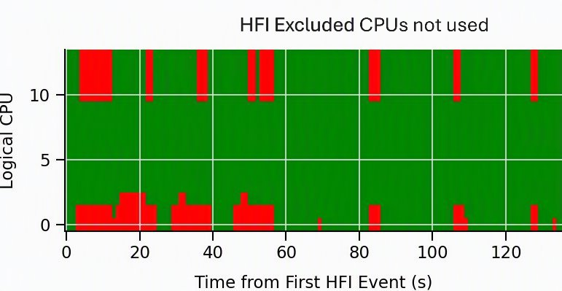
HFI-Driven Available CPUs: Heatmap
Green = Schedulable, Red = HFI Excluded CPUs
Default: SCX LAVD with no change
HFI excluded: With HFI plugin POC to SCX LAVD
System: CachyOS x86_64 CachyOS Deckify
Panther Lake Handheld
Workload : Shadow of the Tomb Raider benchmark

Slide 6
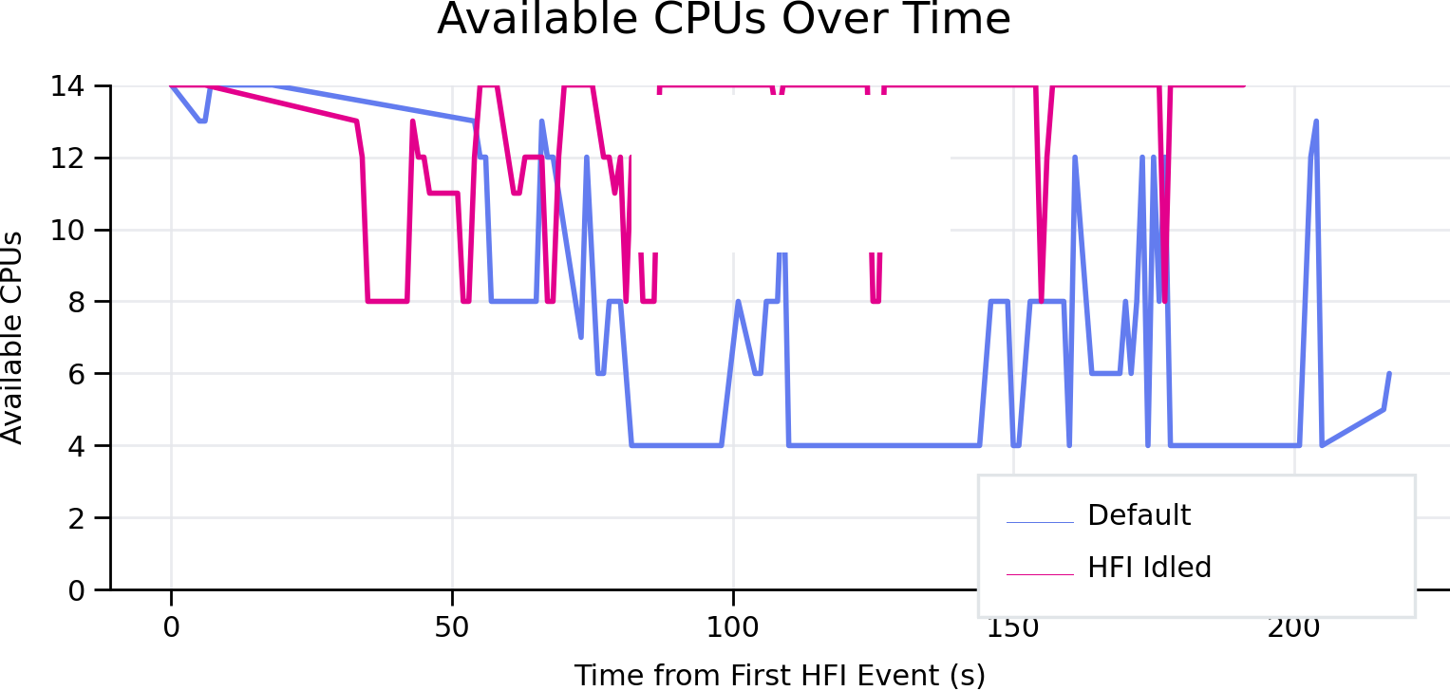
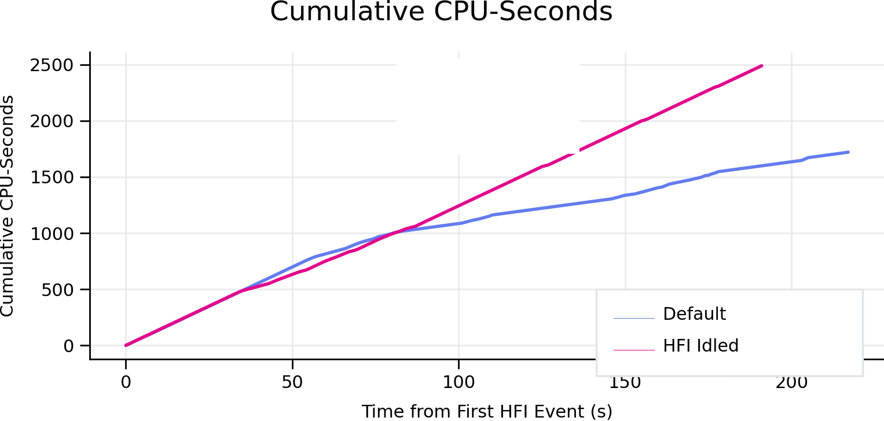
Scheduler-Visible Capacity
✓ More CPUs available
✓ More capacity visible
✓ More CPU-seconds

Slide 7
Real hardware: Shadow of the Tomb Raider
28
Setup PL1 = 10W, range over 3 runs:
Scheduler | Average FPS | 1 % low | Mean excluded | Excluded CPUs busy
EEVDF | 49.1–51.7 | 22.4–25.6 | 5.46–5.64 | 50 %
scx_lavd | 51.8–52.1 | 22.4–23.1 | 5.42–5.45 | 53 %
scx_lavd --hfi | 55.4–55.5 | 26.1–26.2 | 4.82–4.88 | 0.5–1.7 %
+ --hfi-debug | 54.5–54.7 | 25.5–25.7 | 4.62–4.76 | 0.5–2.0 %
The hardware excludes whole domains: P (cpu0–1) + LPE (cpu10–13), sometimes also cpu8–9; E-core perf moves between 32 and 140 (peak 140)
Same package power in every run (12.8–13.5 W; above 10 W because the limit is averaged over 56 s and PL2 allows bursts), GPU busy 91–93 %
Set changes: 33–39 with --hfi vs. 14–22 without — the loop again
--hfi-debug: event → effect median 405–483 ms; no stranding, no watchdog exit

Slide 8
Architecture
9
thermal netlink --> hfi_lib (C) per-CPU {perf, eff} table
|
v
HfiTracker thread (Rust) derives perf_scale, snapshots
| plain stores into the mmap'd .bss
v
BPF globals: hfi_excluded_cpu[] hfi_perf_scale[]
hfi_nr_excluded hfi_nr_throttled hfi_excluded_gen
| |
A: excluded-CPU avoidance B: capacity capping
active/overflow mask rebuild update_effective_capacity()
No new timer: BPF consumes on the existing 10 ms stat tick
Off by default: no socket, no thread, nothing published
--hfi-exclude and --hfi-capacity switch independently, for A/B evaluation

Slide 9
A: excluded-CPU avoidance

Slide 10
Exclude at the mask, not at the pick
11
scx_lavd has ~10 CPU-selection paths, and every one is expressed in terms of two cpumasks: active and overflow, rebuilt every 10 ms.
Approach | Cost
Check HFI at every pick site | ~10 edits; every future path is a new bug
Treat an excluded CPU as offline in the 2 mask builders | 2 edits; all paths inherit it
if (!cpuc || !cpuc->is_online || is_hfi_excluded_cpu(cpu)) {
bpf_cpumask_clear_cpu(cpu, active);
bpf_cpumask_clear_cpu(cpu, ovrflw);
continue;
}
hfi_nr_excluded == 0 short-circuits: one load when nothing is excluded.

Slide 11
The masks alone missed three places
12
Sticky-CPU fast paths test only idleness and skip the mask: a task whose prev_cpu just excluded got handed straight back to it
Overflow re-adds between rebuilds: 8 call sites add a CPU back to the shared overflow set, exposing an excluded CPU to every task for up to 10 ms
Fallback when nothing qualifies: skip excluded CPUs, but remember one, so a task with nowhere else still gets a CPU
After these, select_cpu() never picked an excluded CPU.
Tasks were still running on them.

Slide 12
ops.dispatch() pulls
13
enqueue pushes work toward CPUs; dispatch runs on a CPU and pulls work to itself. A correct push policy does not constrain the pull side.
Leak 1: a count outvoted the mask.
if (use_full_cpus()) /* nr_active >= nr_cpus_onln */
goto consume_out; /* ...and skip every mask test */
nr_active is capacity-derived: it hits 14 under load (2P8E4L setup)
The active mask deliberately omits the 5 excluded CPUs (setup A: nr_active=14, active_weight=9 on most rebuild ticks)
Fix: never take the fast path while anything is excluded

Slide 13
Leak 2: one stuck task licensed the whole queue
14
Every early exit to consume_out means one specific task is stuck here: a pinned prev, a migration-disabled prev, work in the CPU’s own DSQ.
But consume_task() then read all three DSQs, and could steal cross-domain:
DSQ | Contents
per-CPU | tasks that targeted this CPU
per-domain | freely migratable work, shared
per-domain turbulent | shared
One pinned kworker let an excluded CPU drain the shared queue.
Fix: those exits mark themselves; an excluded CPU then reads only its own DSQ.
Outside both masks used to mean “unwanted”. Excluded means forbidden, and that distinction had never had to exist.

Slide 14
Tasks already running there
15
Steering fixes future placements. evict_hfi_excluded_cpus() issues SCX_KICK_PREEMPT to each newly excluded CPU, once per published set.
The order is what makes it work:
do_core_compaction(); /* masks now leave out the excluded CPUs */
...
if (hfi_evict_excluded)
evict_hfi_excluded_cpus(); /* only now kick them */
Kick first, and the CPU re-enters dispatch() while the masks still include it — and just pulls in different work.

Slide 15
Excluded is not offline
16
Exclusion is a recommendation about migratable work. The CPU stays online, takes interrupts, and owns per-CPU kernel work nobody else can do.
A task that can only run there still runs there. kworker/12:1, ksoftirqd/12: if exclusion were absolute, workqueues back up and RCU stalls
fallbacks honor p->cpus_ptr
an excluded CPU keeps draining its own per-CPU DSQ
a pinned task still gets its kick
Never exclude every online CPU, whatever HFI says. Checked in userspace before publishing, and in BPF on every read
So the residual is never zero, and shouldn’t be.

Slide 16
B: capacity capping

Slide 17
A third term in an existing min()
18
update_effective_capacity() already said, before any HFI work:
the CPU capacity can be throttled without changing the software policy or notifying the loss of capacity
…and inferred it from the highest frequency observed, gated on high utilization, through a moving average.
HFI is exactly that missing notification.
effective_capacity = min(capacity_policy, /* scaling_max_freq, hw_pressure */
capacity_observed, /* max freq actually seen */
capacity_hfi) /* new: hardware-stated */
No utilization precondition, no averaging lag, and no new selection logic: capacity sums, compaction, and big-core ranking all inherit it.

Slide 18
Scale against the CPU’s own peak
19
perf_scale[cpu] = perf[cpu] / max_ever_seen(perf[cpu]) /* 1.0 == own peak */
Per CPU, not across the machine: no assumption about how classes map to capacity units
Unthrottled yields exactly 1.0, so the min() is an exact no-op: inert, not merely cheap

Slide 19
Effect: the active set widens
20
Weakened CPUs contribute less capacity, so more of them are needed to cover the same demand.
Setup B, throttled CPUs at 25% of peak, 6 repeats:
Throttled CPUs | mean nr_active, per repeat
0 | 7.35 / 12.39 / 7.02 / 7.91 / 12.39 / 9.12
5 (cpu0–4) | 11.39 / 11.24 / 11.06 / 11.47 / 11.09 / 11.65
9 (cpu0–8) | 12.42 / 12.40 / 12.42 / 12.39 / 13.89 / 12.49
Throttling widens the set in 4 of 6 repeats. In repeats 2 and 5 the unthrottled baseline already sat at 12.4, under the same load (checked with top); we don’t know why yet. With cpu13 excluded, 13 CPUs is near the ceiling.

Slide 20
Sharing state with BPF

Slide 21
Lock-free publication through .bss
22
.bss is an mmap’d BPF_F_MMAPABLE array: a Rust store is a BPF-visible write. No syscall, no map update. Every field has one writer.
for cpu in 0..n { bss.hfi_excluded_cpu[cpu] = ...; } // 1. the arrays
compiler_fence(Release);
bss.hfi_nr_excluded = n; // 2. the gate
compiler_fence(Release);
bss.hfi_excluded_gen += 1; // 3. "rebuild the masks"
Every BPF reader starts with if (!READ_ONCE(hfi_nr_excluded)) return false;
HFI is x86-only, and TSO keeps stores in order: a compiler fence is all it takes
0→N is safe, and N→0 is safe. N→M can briefly mix sets, and the next tick settles it

Slide 22
Status and Q&A

Slide 23
Status
36
Patch series for scx_lavd in preparation for the sched_ext list
hfi_lib: a small netlink reader
excluded-CPU avoidance, including the dispatch fixes and eviction
capacity capping
test tooling: --hfi-test-*, hfi_inject, test_hfi_*.sh
design document
Open, found on real hardware: when a whole compute domain is excluded, tasks already queued on it can be stranded (1 in 7 Setup C runs; watchdog exit after 43.5 s)
Open, found in one setup (1 of 3 --hfi-debug runs): 5 starts of a migratable task on an excluded CPU after the rebuild; select_cpu itself returned it (its prev_cpu). Root cause not yet confirmed
Next: among idle candidates, break ties by class — perf class for perf-critical tasks, eff class otherwise
Thank you. Questions?

Slide 24
Questions for the room
34
Is there a value to continue to do this work?
Should “excluded” be a sched_ext concept? Excluding a CPU from selection is easy. Stopping it from pulling took two non-obvious fixes in dispatch(). Every scheduler would rediscover them. Should the core offer “soft-offline for migratable work”?
Kernel → BPF, without the userspace hop? Today: netlink → thread → main loop → .bss → 10 ms tick. Setup C: median 335–513 ms from event to effect, dominated by the 1 s main-loop wait, and the userspace thread is itself a task the exclusion can strand. A kfunc, or a BPF-visible HFI table?
What do we do with a high eff score? LPE cores report the top eff value (raw 255) with perf 124 only when the load is light: Should non-latency-critical work be placed by eff class, and latency-critical work by perf class?

